Slide 1


Department of ICT
A project(1/major)/Mid Term defense on:
“Intrusion Detection System: CyberRaksha”
Project Members:
Rosan Shrestha(210144)
Saurav Sijapati(210129)
Alisha Malla Thakuri(120137)
Netrahari Pahadi(210119)
Submitted to:
Department of ICT
Cosmos College of Management and Technology
Date : 28 December, 2025

Slide 2


Introduction
Cyber attacks are growing fast
We need smart, IDS using ensemble machine learning
Old IDS systems can’t detect new threats
Anomaly-based ML methods help detect such threats

Slide 3
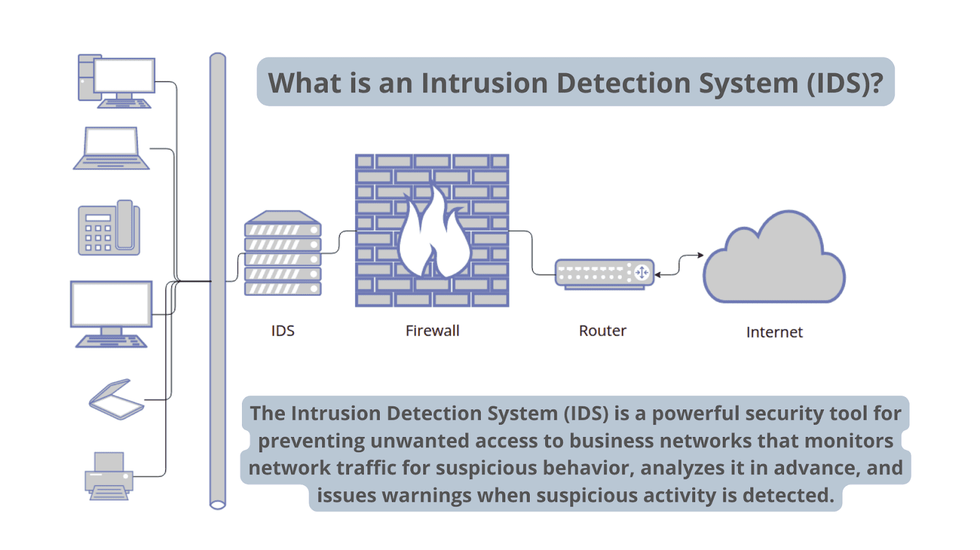
INTRODUCTION

Slide 4
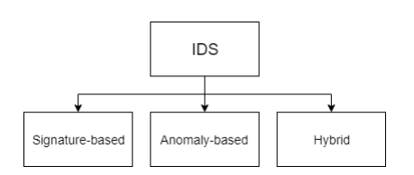

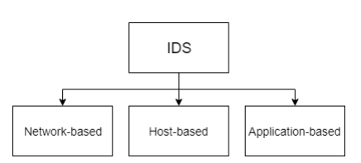




Types of IDS
1.Based on Analyze activity
2.Based on Detection Method

Slide 5

Main Objective:
To Develop anomaly-based IDS using Ensemble ML
Specific Objective:
To detect know and unknown attack
To Use datasets like CICIDS2017
To Test different ML models
To Boost accuracy and lower false alarms

Slide 6

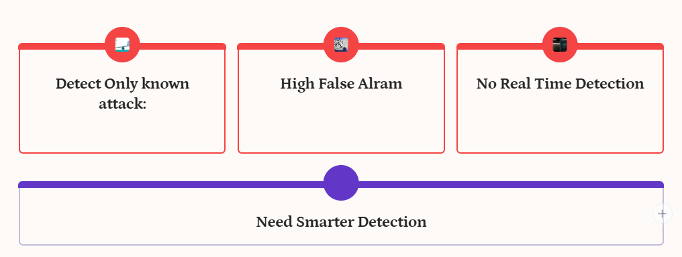



Slide 7



Proposed System
Anomaly-Based IDS using Ensemble ML
Detect deviations from normal traffic behavior
Use supervised ML models
Can detect unknown attacks
Use stacking Ensemble ML

Slide 8

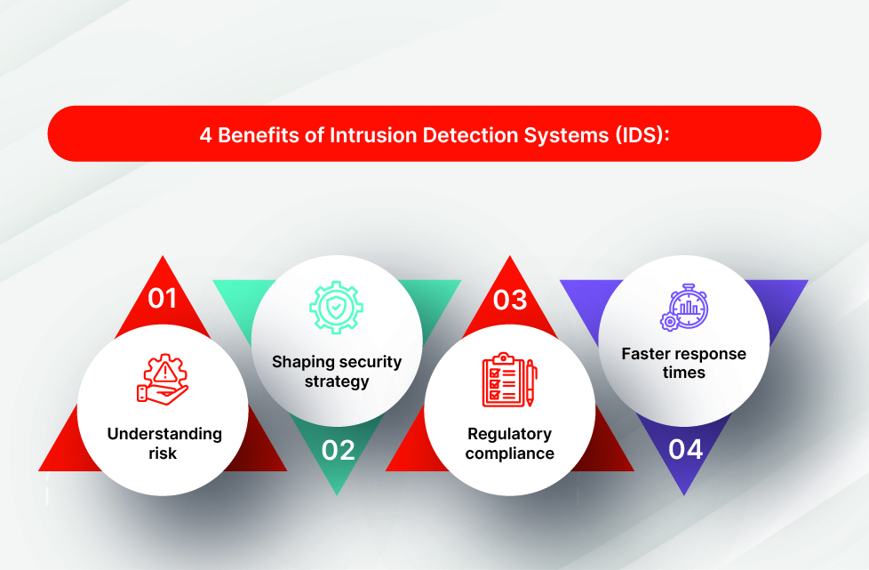
Benefits of IDS

Slide 9


Cannot Stop Attacks The system can only detect threats, not block them.
Too Many Logs It creates a lot of logs, which can be hard to check and manage.
Limited Accuracy on New Attacks It may not work well on attack types it hasn’t seen before.
Uses System Resources Real-time monitoring can slow down the system or network.

Slide 10

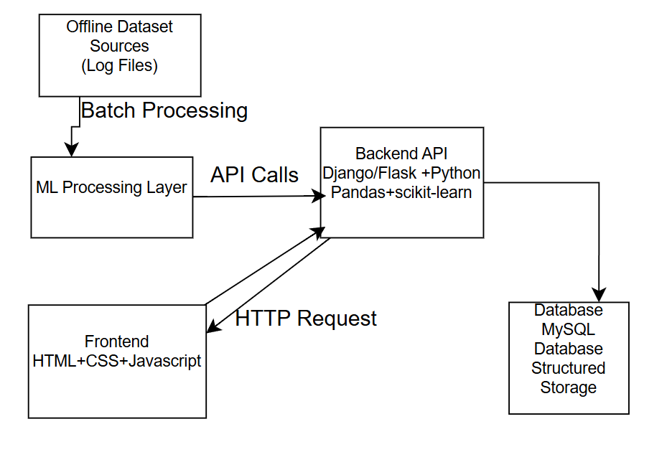
Figure 1: High‑Level System Architecture of the Anomaly‑Based IDS

Slide 11

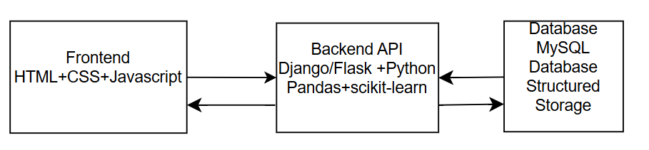

Slide 12

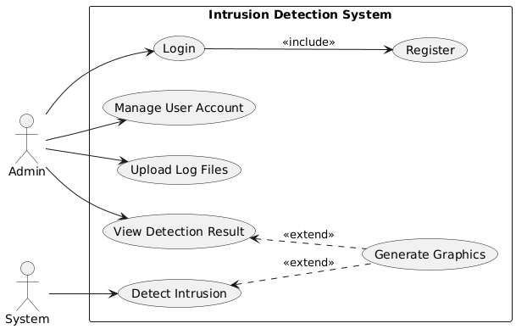
Actor:
1.Admin 2.System
Usecases:
Login
Register
Manage User Account
Upload log files
View Detection Result
Generate Graphics
Detect Intusion

Slide 13

Tools and Technology
Programming Language: Python
ML Libraries: scikit‑learn, Label Encoder
Data Handling & Visualization: pandas, NumPy, matplotlib, seaborn
Web Frameworks: Flask or Django ( HTML/CSS/JavaScript)
Database: MySQL
Dev Environment: Jupyter Notebook, VS Code, google colab
Version Control: Git & GitHub
Datasets: CICIDS2017

Slide 14

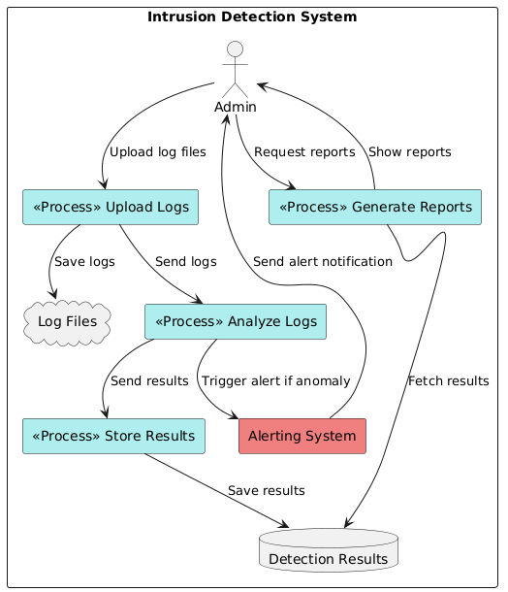
Shows the workflow of an IDS
Admin uploads log files to the system.
Logs are saved and sent for analysis.
Anomalies trigger alerts to the admin.
Admin can request and view reports based on detection results.
Detection results are stored in a database.
DFD of Intrusion Detection System

Slide 15


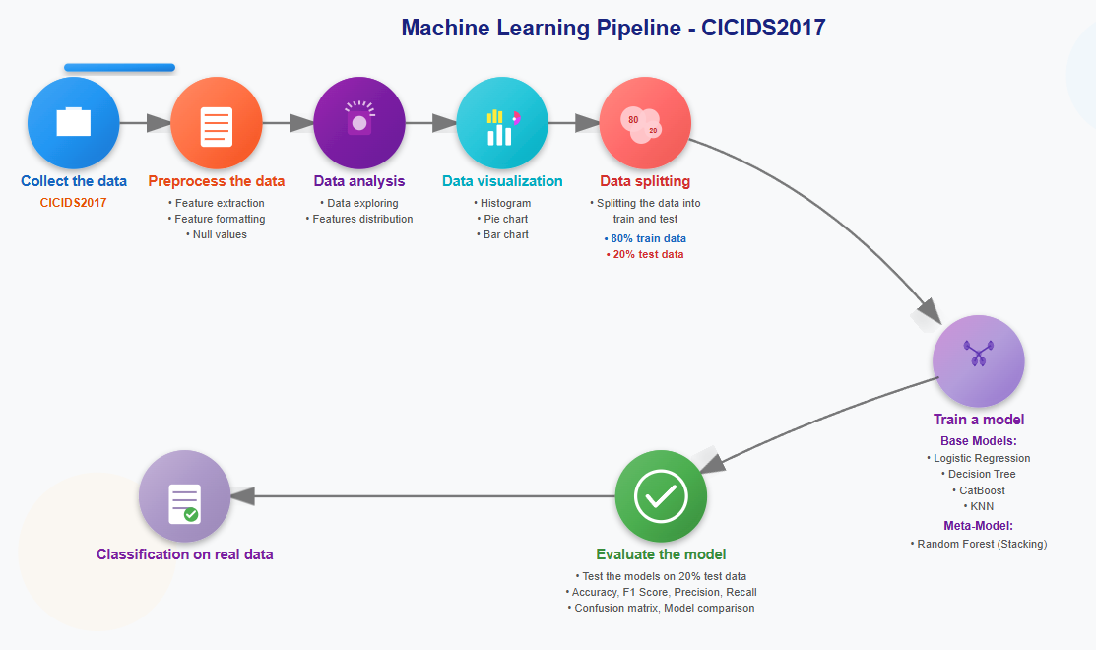

Slide 16
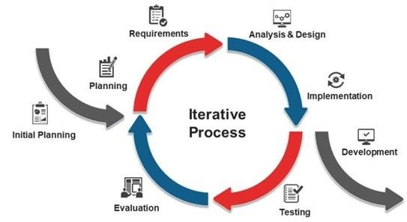

Process Model
Phases of Iterative model
Initial Planning
Requirements
Analysis and Design
Implementation
Development
Testing
Evaluation

Slide 17
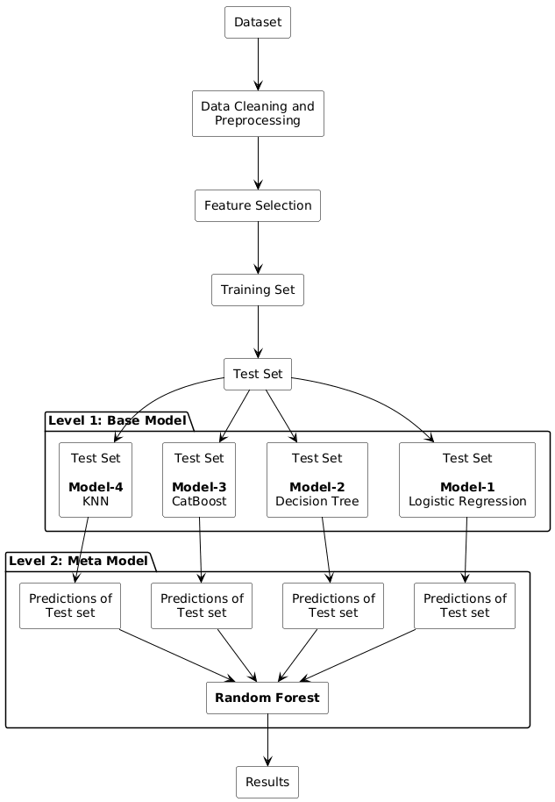
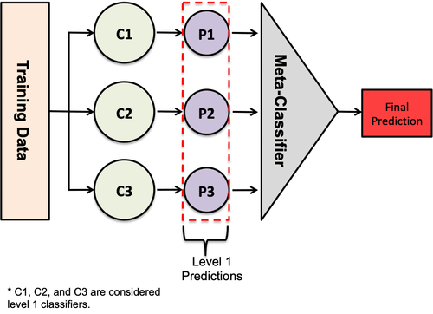
Static Ensemble workflow

Slide 18
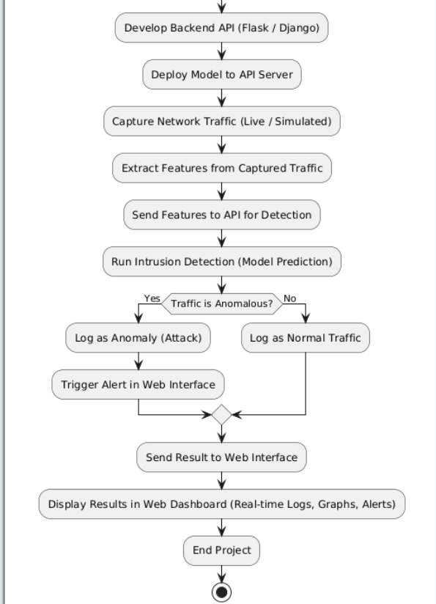
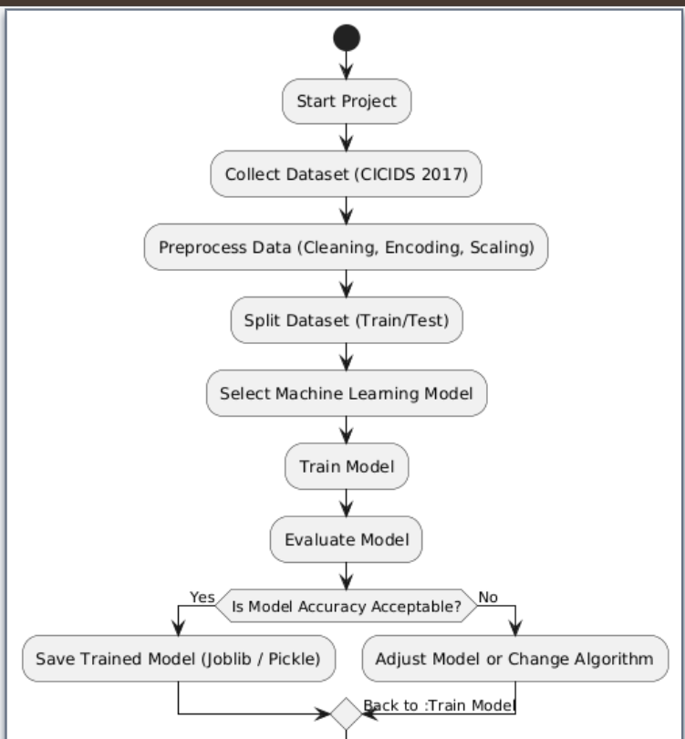

IDS Flowchart

Slide 19

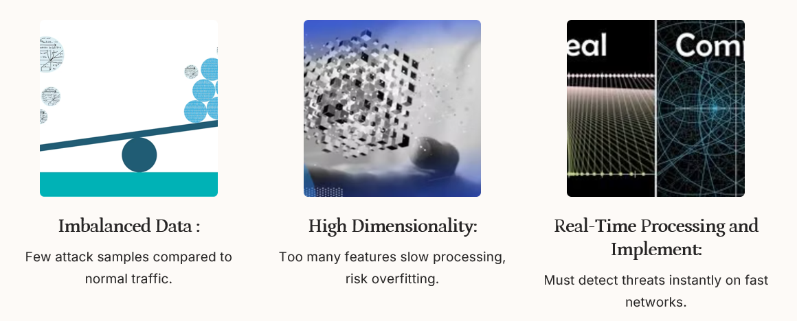

Slide 20

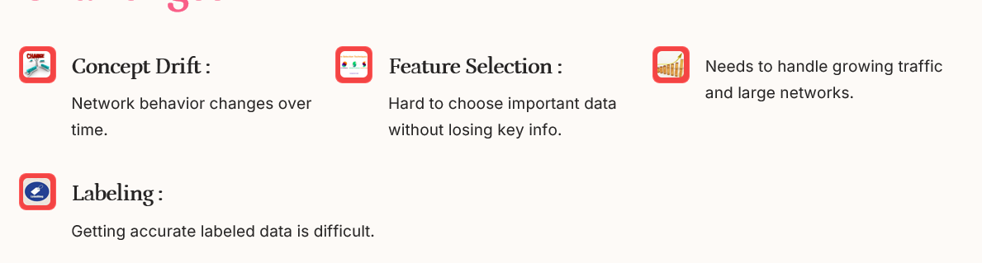


Slide 21

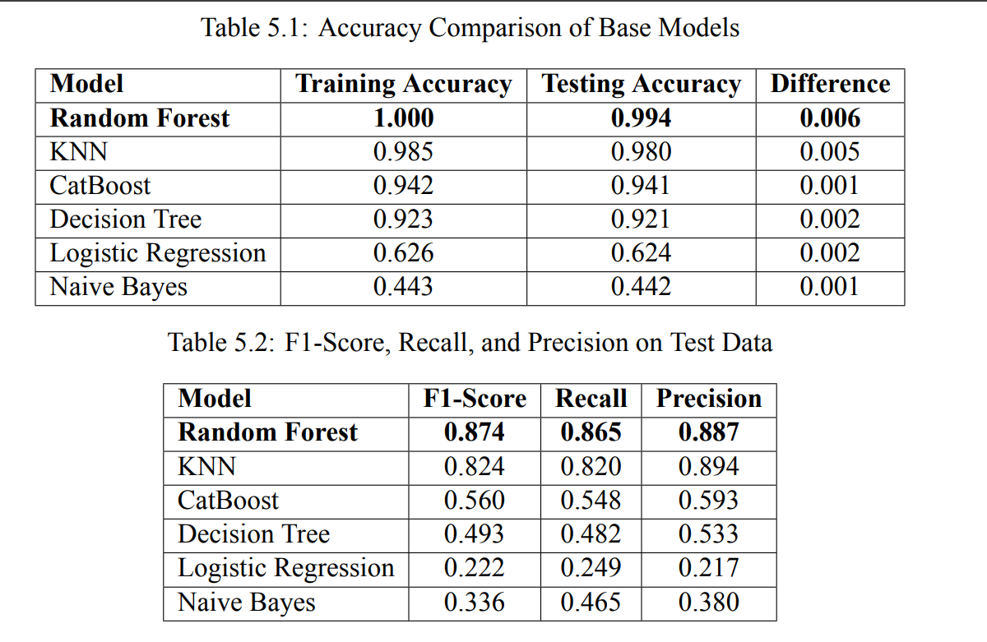

Slide 22
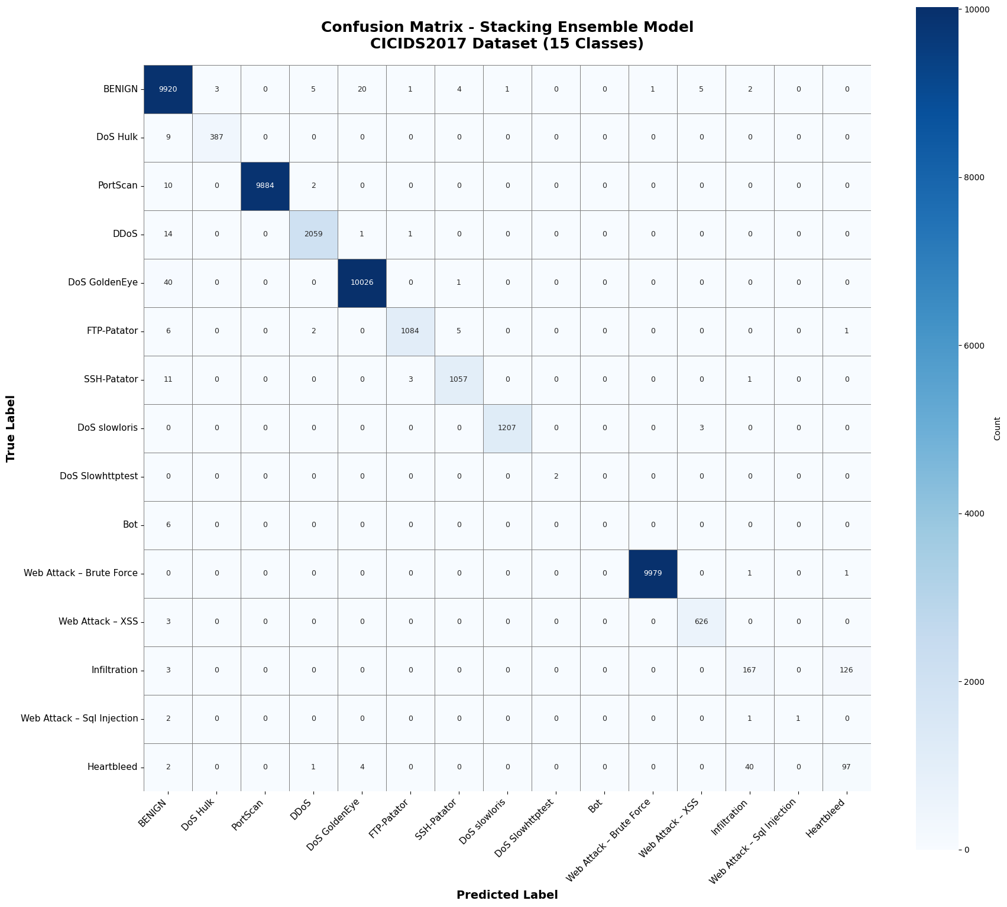

Slide 23

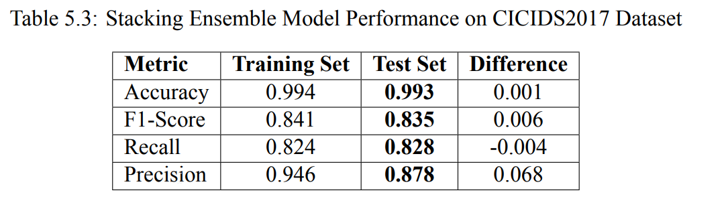

Slide 24
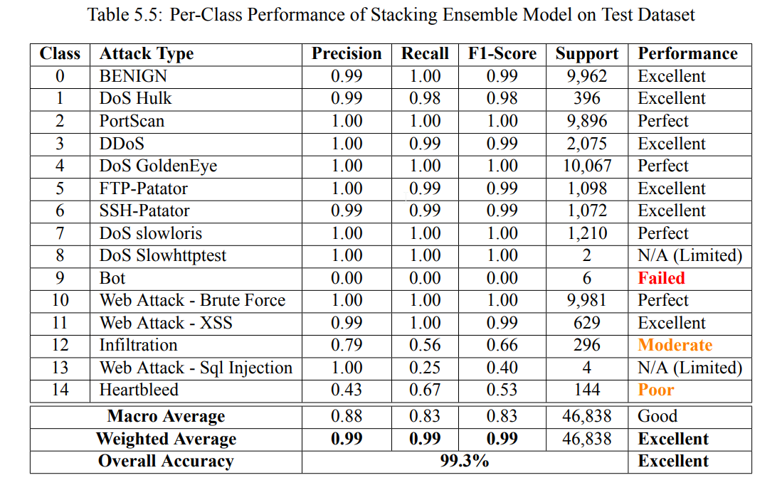

Slide 25
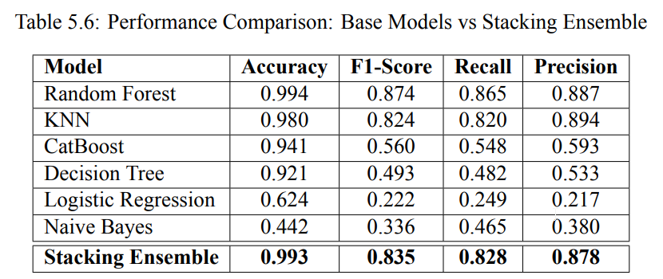
Base VS Meta

Slide 26
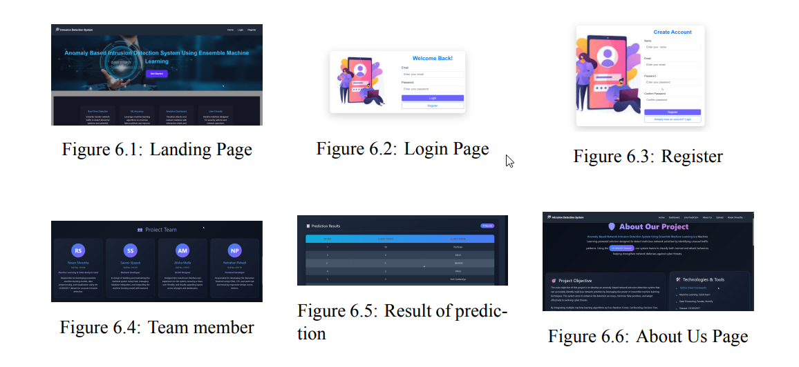
Web Application outputs

Slide 27

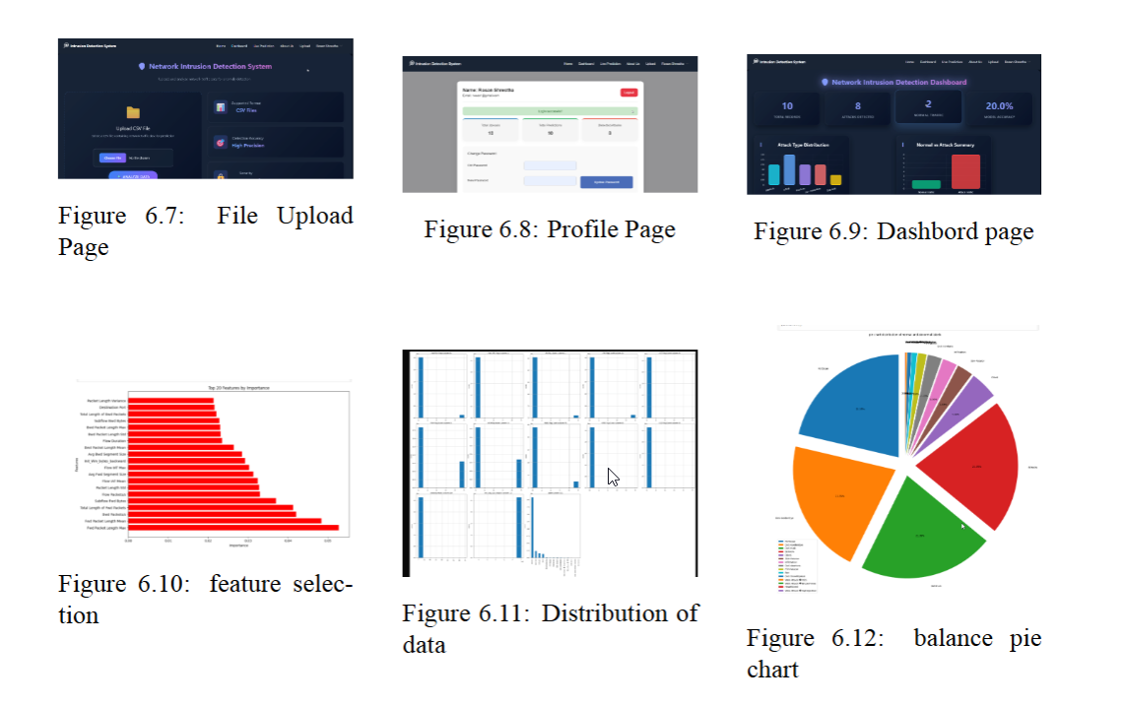

Slide 28

Gantt Chart

Slide 29
Conclusion
Developed an ML‑powered anomaly‑based IDS that learns normal network behavior
Demonstrated accurate detection of unknown threats with reduced false alarms

Slide 30
Thank You!

